Slide 1
Network Analysis
By Rebecca Ruppel, Bhavya Medishetty & Maha Siam
March 23, 2017
Women In Data Science Meetup

Slide 2
Outline
Introduction and background
Creating Graphs in NetworkX
Data loading and visualization
Centrality
Cliques, triangles and triadic closure
Community detection and statistical inference

Slide 3
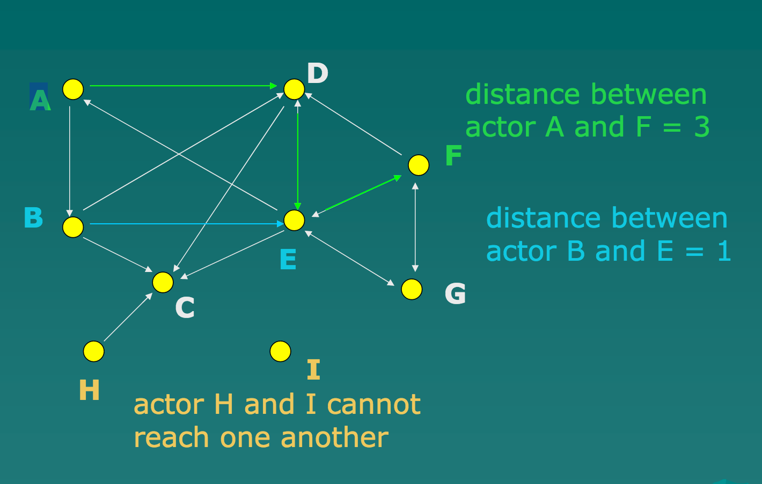
What is Network?
A pattern of interconnection among a set of things.
A collection of points joined by lines
Network can be thought of as :
a complicated data structure,
a complex system,
a way of exploring data.

Slide 4
The basics of network theory
Networks, a.k.a. graphs, are an immensely useful modeling tool to model complex relational problems.
Networks are comprised of two main entities: Nodes and Edges
Nodes: commonly represented as circles. In the academic literature, nodes are also known as "vertices".
Node/vertex: the entity of analysis which has a relationship.
Node is used in the network context.
Vertex is used in the graph theory context.
Both terms are often used interchangeably.

Slide 5
The basics of network theory
Link/edge/relationship: the connections between the nodes.
Edges: commonly represented as lines between circles.Edges denote relationships between the nodes.
Attributes: Both nodes and edges can store attributes, which contain additional data about that object.
Weight: a common attribute of edges use to indicate strength or value of a relationship.
Degree: number of edges or connections a node has.

Slide 6
Basics
Node/Vertex
Edge
Directed
Connectivity
Path
Weight
Degree

Slide 7
What is Social Network and Social Network Analysis?
Social Network: a network where the “things” are people and “interconnections” are social interactions.
Social Network Analysis (SNA): the application of graph and network theory to investigate social structures.
Notes:
Social network is a network where the things are people and interconnections are social interactions. like in Facebook if 2 people are friends, we can call social interconnection.

Slide 8
The basics of network theory
In a network, if two nodes are joined together by an edge, then they are neighbors of one another.
Type of network :
directed
undirected

Slide 9
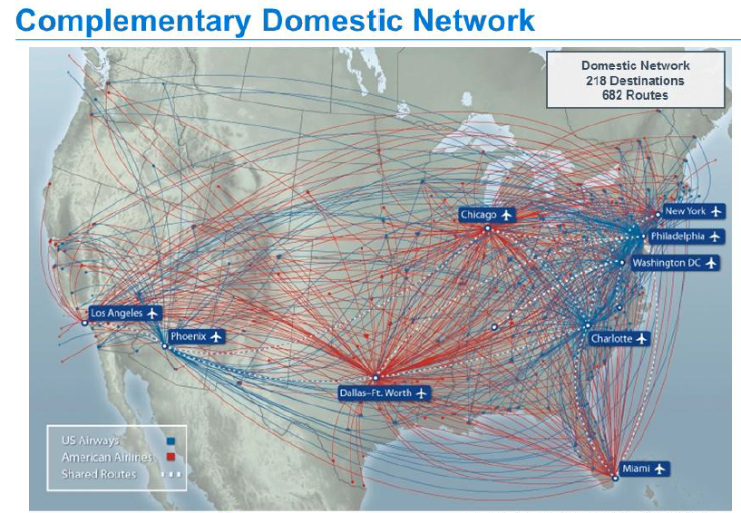
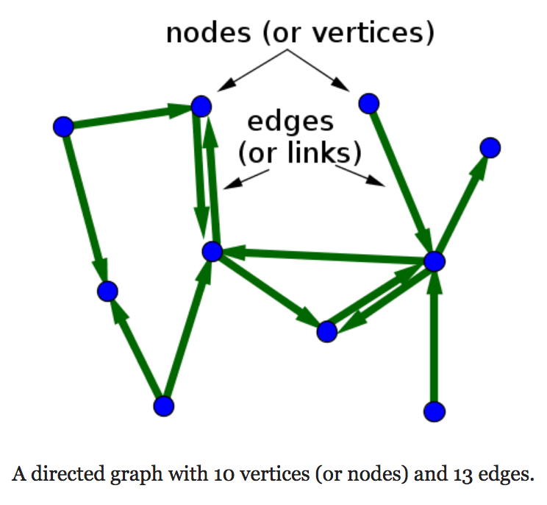
Example of Network : Directed Network
Air traffic network: Airports are nodes, flights between airports are the edges.

Slide 10
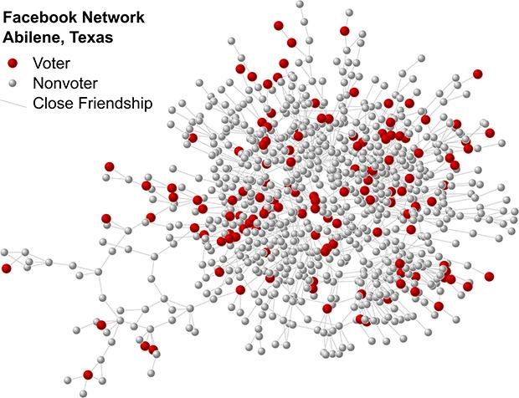
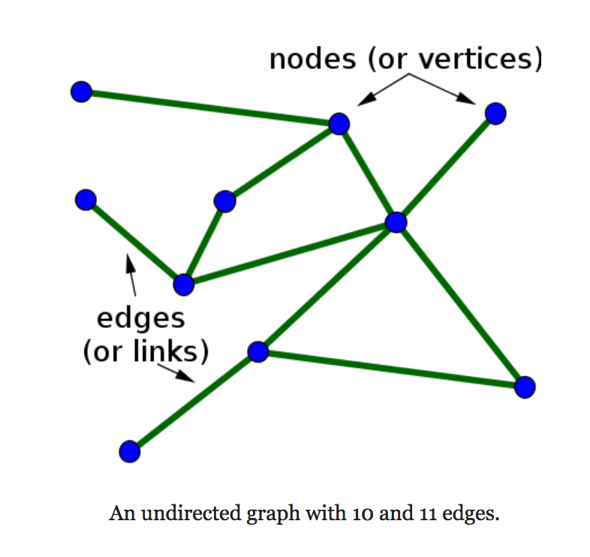
Sample of Network : Undirected network
Facebook's network: Individuals are nodes, edges are drawn between individuals who are FB friends with one another.

Slide 11
Social Network Analysis : What for?
Businesses use SNA to analyze and improve communication flow in their organization, or with their networks or partners and customers.
Marketing. Social Networks are the most important way to obtain valuable information in marketing, like communities, or influencers.
Crime detection. Law enforcement agencies(and the army) use SNA to identify criminal and terrorist networks from traces of communication that they collect; and then identify key players in these networks.
Relationships and reputation.Social Network sites like Facebook use basic elements of SNA to identify and recommend potential friends based on friends-of-friends.

Slide 12
Intro to NetworkX
NetworkX is a Python language software package for the creation, manipulation, and study of the structure, dynamics, and functions of complex networks.
With NetworkX you can:
load and store networks in standard and nonstandard data formats,
generate many types of random and classic networks,
analyze network structure,
build network models,
design new network algorithms,
draw networks, and much more.

Slide 13
Credits
https://github.com/ericmjl/Network-Analysis-Made-Simple
YouTube video from Rob Chew, Peter Baumgartner | Network Analysis Tutorial with NetworkX
Sarah Guido, Celia La - Twitter Network Analysis with NetworkX - PyCon 2015
Social Network Analysis by Giorgos Cheliotis

